Slide 1

Flipping Genius!
A Web-Based Card Memory Game
Developed by: David Coles, Carrick Entwistle, Nils Olov Lugner, Josh Williams

Slide 2
Planning & Design
Ideation
UX Design
Technologies
A fun, interactive memory game to challenge players of all ages and improve cognitive skills. Use Case: Casual gamers looking for a quick, engaging brain-training experience. Business Case: A simple, accessible game with potential for ads, premium features, or educational and care home use. (currently in talks with a Care home Provider Group.) Target Audience: Puzzle lovers, Alzheimers & Dementia sufferers, Short term memory training, students, and anyone wanting to boost memory and focus.
Flipping Genius is designed with user stories in mind, ensuring an intuitive and engaging experience. The responsive UI adapts seamlessly across all devices, providing smooth gameplay and easy navigation. Accessibility features enhance usability for all players, while interactive elements make the game immersive and fun. Every aspect, from card flipping to difficulty selection, is crafted to offer a seamless, user-friendly experience that works effortlessly on desktops, tablets, and mobile devices.
HTML – Structuring the game elements
CSS – Styling and animations
JavaScript – Game logic and interactivity
Bootstrap – Responsive design and layout
FontAwesome – Icons for UI enhancements
CSS-Pattern.com - Used for the back style of the cards
RealFaviconGenerator - Create a favicon file

Slide 3
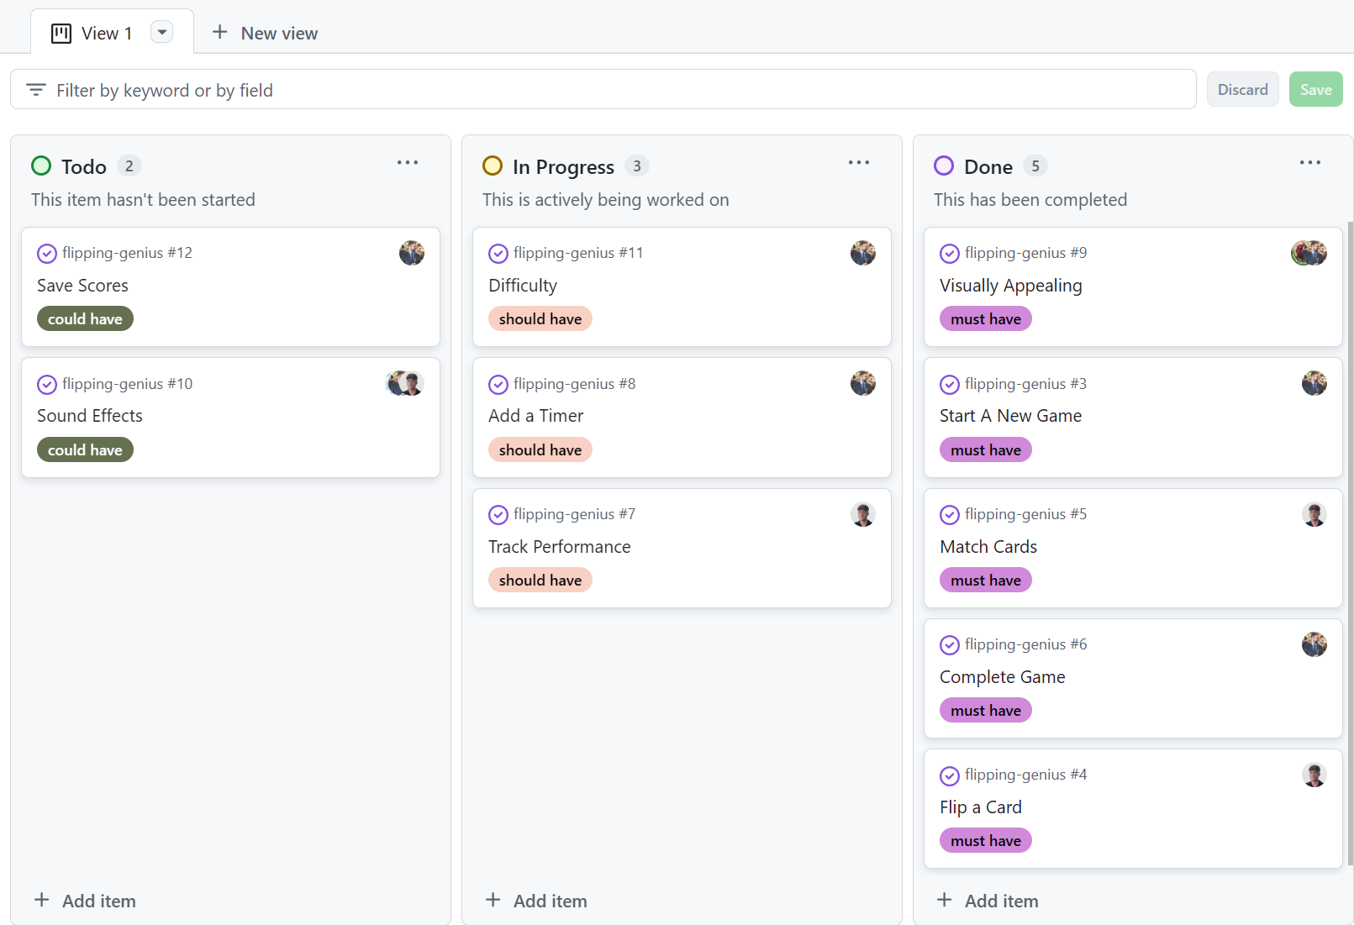
Project Board
Flipping Genius was developed using Agile methodologies, focusing on an MVP approach. We created multiple user stories, each broken into assigned tasks for efficient workflow. Using MoSCoW prioritisation, we ensured essential features were completed first while tracking enhancements in the project backlog. This structured approach allowed iterative improvements, clear task distribution, and a well-organised development process, ensuring a smooth and focused project execution.

Slide 4
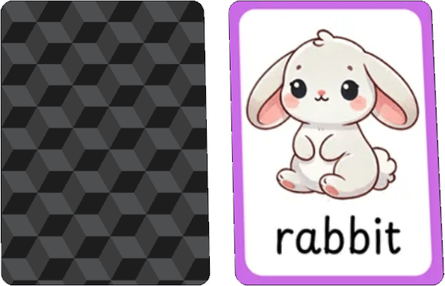
Features
Start Button - Starts a new game
Difficulty Setting - Choose from Easy (4x4), Medium (6x6) and Hard (8x8)
Card Design Options - Choose from Animals, Fruits or Colours more options will be added to cater for different market needs.
High Scores - Display the current high score for each difficulty level
Instructions - View the instructions for the game Mute Sounds - Choose whether the sounds play or not.
Sound Effects
Visuals
The sounds play when a card is flipped, when a match is made, when you win the game or when the cards are being dealt to the game board.
The design, animation and layout all add to the visuals making it an enjoyable experience

Slide 5
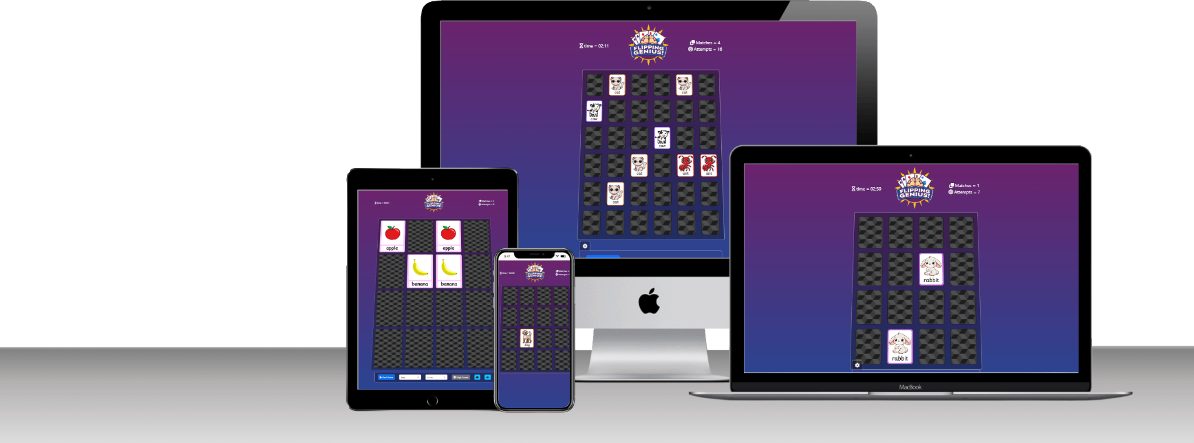
Project Links
Project Board
https://github.com/users/CARRIXK/projects/7
Version Control https://github.com/CARRIXK/flipping-genius
Deployed Link: https://carrixk.github.io/flipping-genius/

Slide 6
Collaboration & Outcomes
Outcomes
Collaboration
Development Problems
Summary
We’re proud of Flipping Genius and how it delivers a fun, polished, and engaging experience. In the next development cycle, we would aim to add more card designs, both front and back. If we could start again, we'd refine our planning phase, focusing more on early testing and scalability to streamline development. Overall, the project was a success, and we’re excited for future improvements and potential expansions.
During development, we faced challenges like sound restrictions—browsers block audio until user interaction. A start screen resolved this by ensuring an initial click before the game starts. We also tackled dynamic board scaling, event listener optimisation, and responsive design. Using MoSCoW prioritisation, we focused on core gameplay first. If starting again, we’d prototype key features earlier.
Working on Flipping Genius was a valuable experience, though a couple of team members struggled to participate fully. Despite this, collaboration remained strong, and we successfully tackled key challenges. We're satisfied with the final product, having learned a lot about Agile planning, UI design, and debugging. This experience reinforced the importance of early testing and clear communication.

Slide 7
Q&A

